Slide 1
CORE JAVA DAY15
NEEHARIKA

Slide 2
Numeric Streams
double[] --> DoubleStream
int[] --> IntStream
long[] --> LongStream

Slide 3
Java Collectors
Collectors is a final class that extends Object class. It provides reduction operations, such as accumulating elements into collections, summarizing elements according to various criteria, etc.

Slide 4
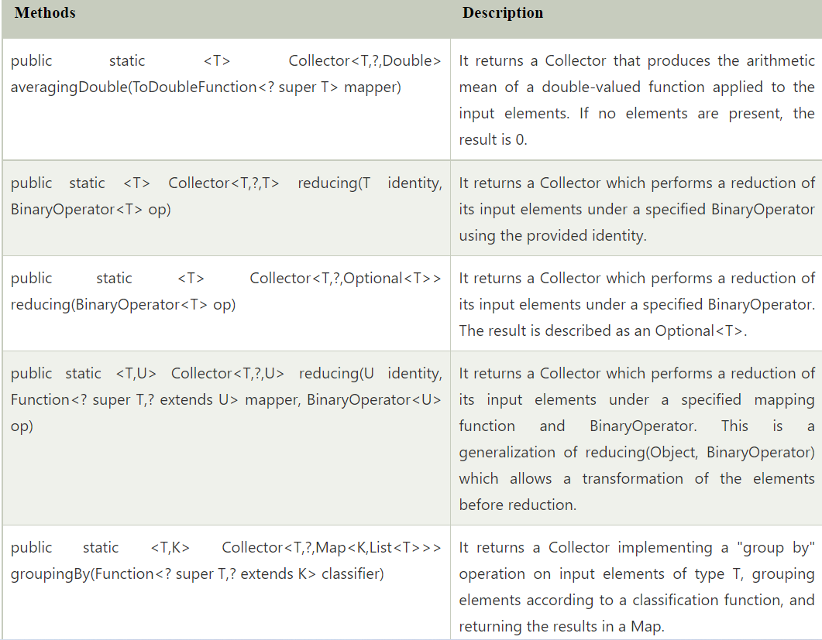

Slide 5
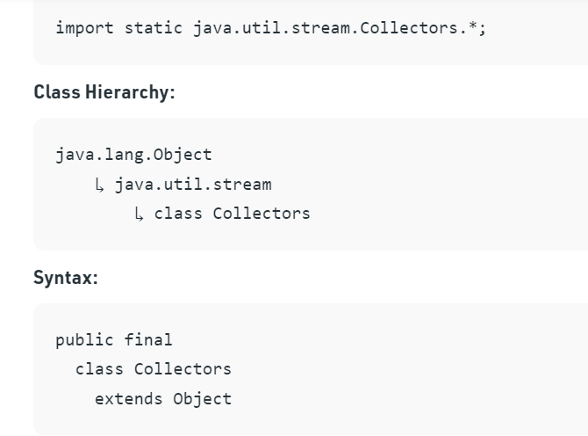

Slide 6
Methods inside the Collectors Class

Slide 7
Collectors partitioningBy() method in Java
Collectors partitioningBy() method is a predefined method of java.util.stream.Collectors class which is used to partition a stream of objects(or a set of elements) based on a given predicate. There are two overloaded variants of the method that are present. One takes only a predicate as a parameter whereas the other takes both predicate and a collector instance as parameters.

Slide 8
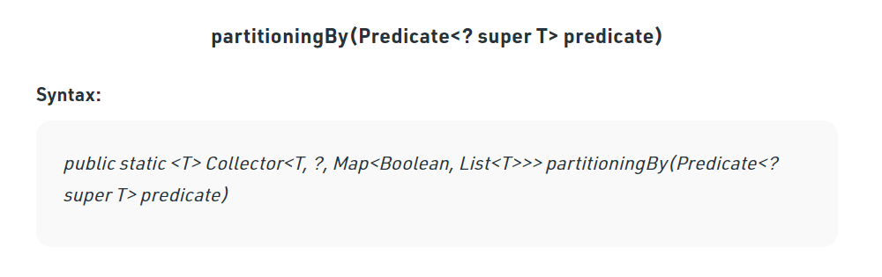

Slide 9
Interface Collector<T, A, R>: A mutable reduction operation that accumulates input elements into a mutable result container, optionally transforming the accumulated result into a final representation after all input elements have been processed. Reduction operations can be performed either sequentially or in parallel.
T: The type of input elements to the reduction operation.
A: The mutable accumulation type of the reduction operation.
R: The result type of the reduction operation.
Map<Boolean, List<T>>: The map containing the output.Keys are boolean values(true or false) and the corresponding values are lists containing elements of type T.
Parameters: This method takes a mandatory parameter predicate which an instance of a Predicate Interface of type T.
Return Value: This method returns a Collector implementing the partitioning operation.

Slide 10
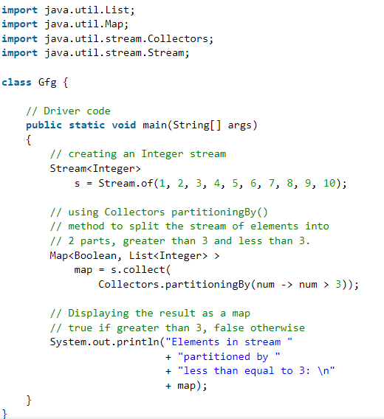

Slide 11
Collectors groupingBy() method in Java
The groupingBy() method of Collectors class in Java are used for grouping objects by some property and storing results in a Map instance. In order to use it, we always need to specify a property by which the grouping would be performed. This method provides similar functionality to SQL’s GROUP BY clause.

Slide 12
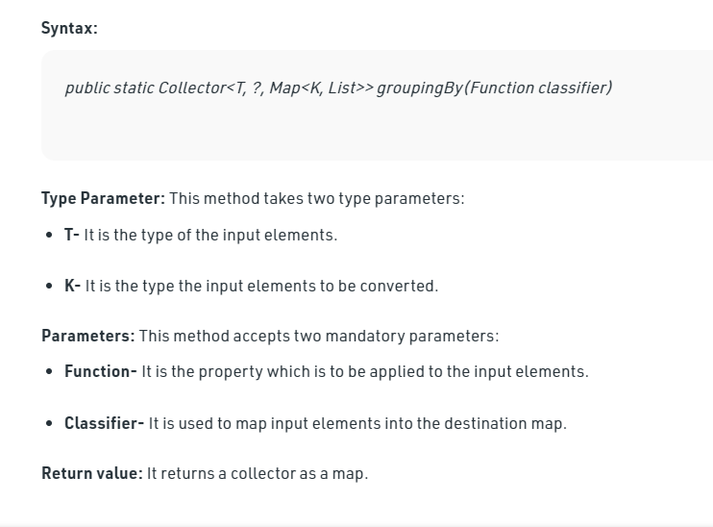

Slide 13
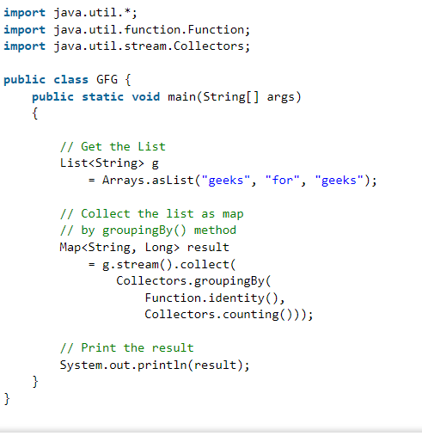

Slide 14
What is Java Parallel Streams?
Java Parallel Streams is a feature of Java 8 and higher, meant for utilizing multiple cores of the processor. Normally any java code has one stream of processing, where it is executed sequentially. Whereas by using parallel streams, we can divide the code into multiple streams that are executed in parallel on separate cores and the final result is the combination of the individual outcomes.

Slide 15
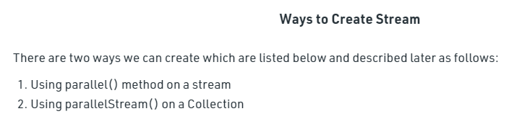

Slide 16
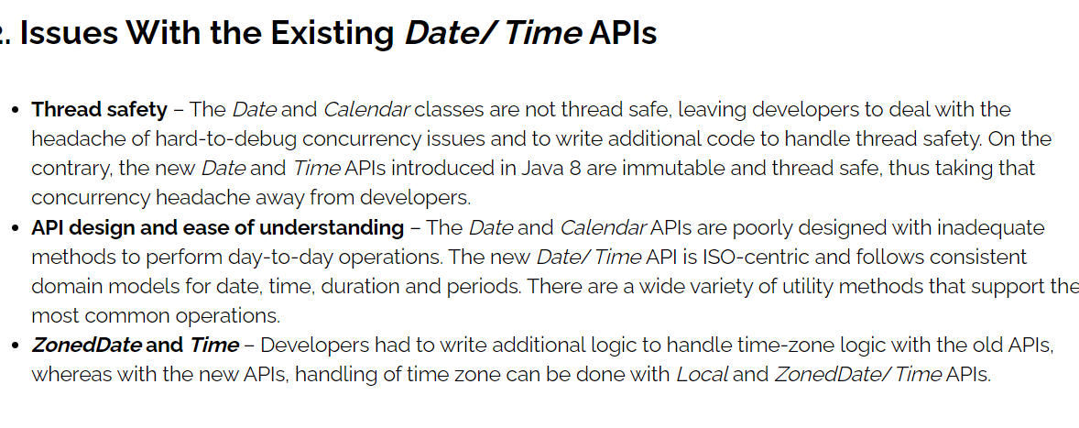

Slide 17
Using LocalDate, LocalTime and LocalDateTime
The most commonly used classes are LocalDate, LocalTime and LocalDateTime. As their names indicate, they represent the local date/time from the context of the observer.
We mainly use these classes when time zones are not required to be explicitly specified in the context. As part of this section, we will cover the most commonly used APIs.

Slide 18
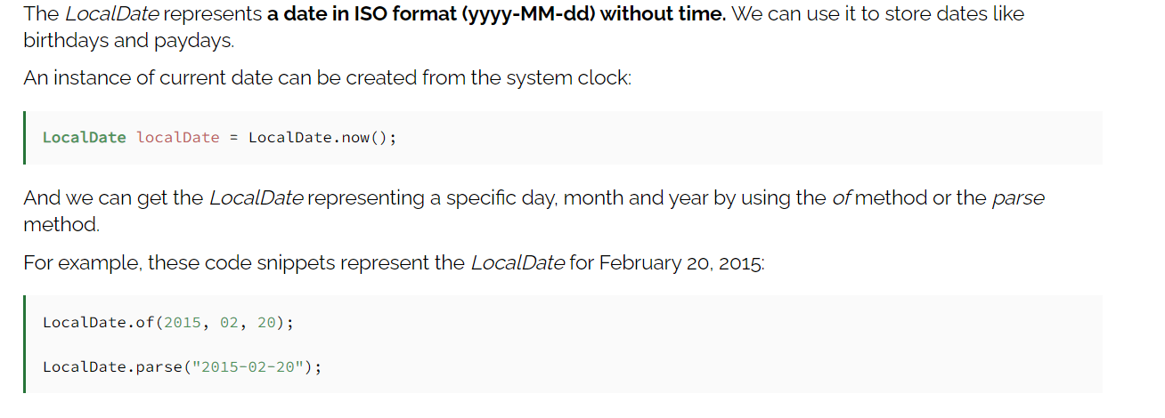
Working With LocalDate

Slide 19
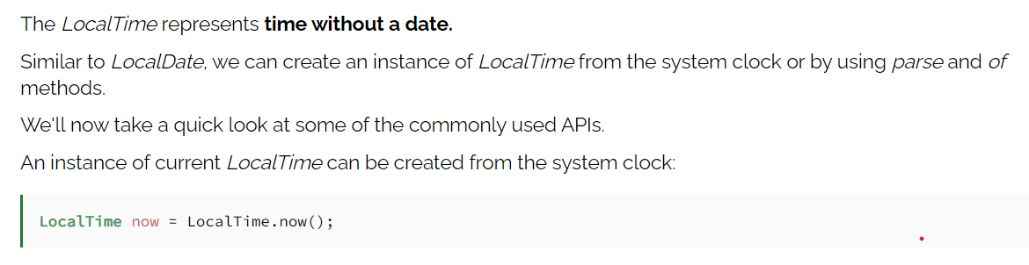
. Working With LocalTime

Slide 20
Working With LocalDateTime
LocalDateTime is used to represent a combination of date and time. This is the most commonly used class when we need a combination of date and time.

Slide 21
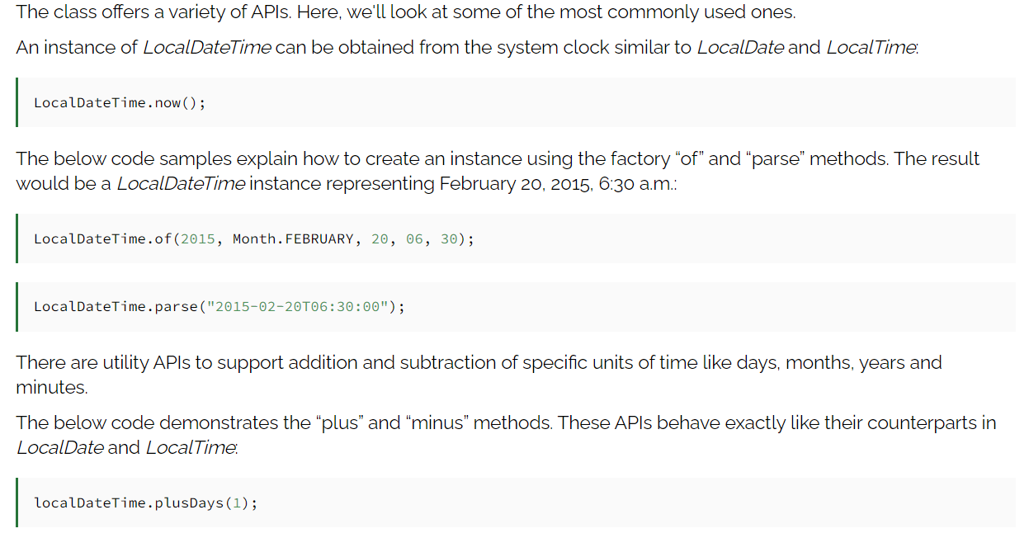

Slide 22
Using ZonedDateTime API
Java 8 provides ZonedDateTime when we need to deal with time-zone-specific date and time. The ZoneId is an identifier used to represent different zones. There are about 40 different time zones, and the ZoneId represents them as follows.

Slide 23
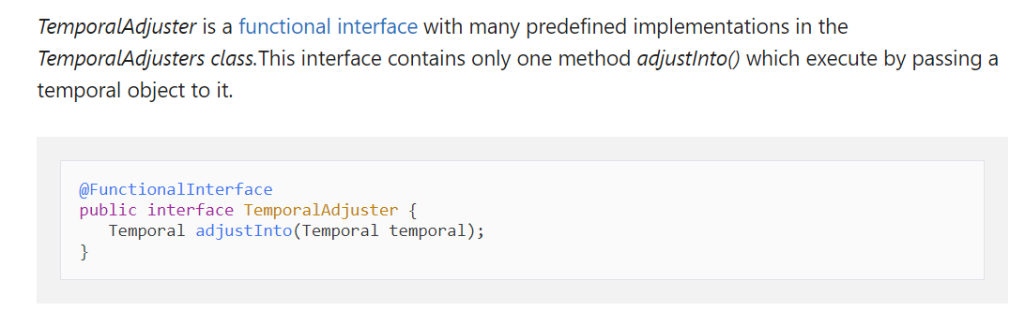
TemporalAdjuster

Slide 24
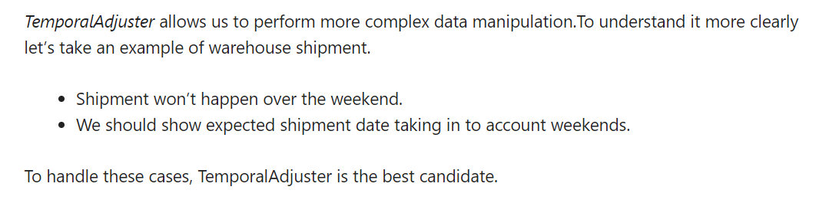

Slide 25
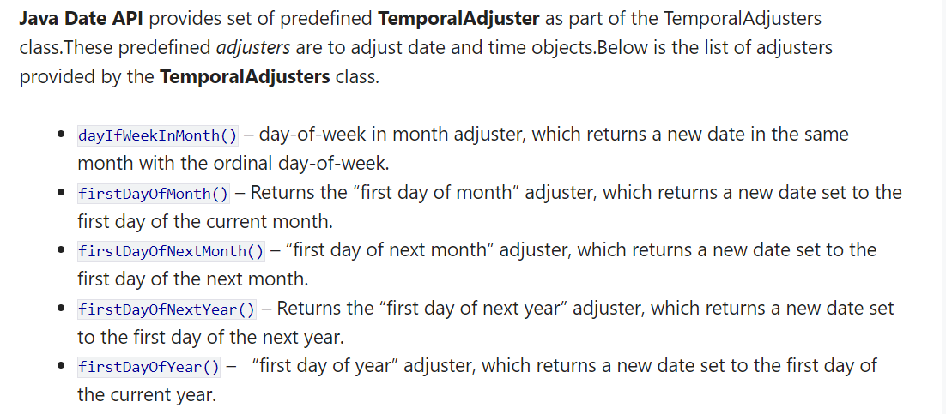

Slide 26
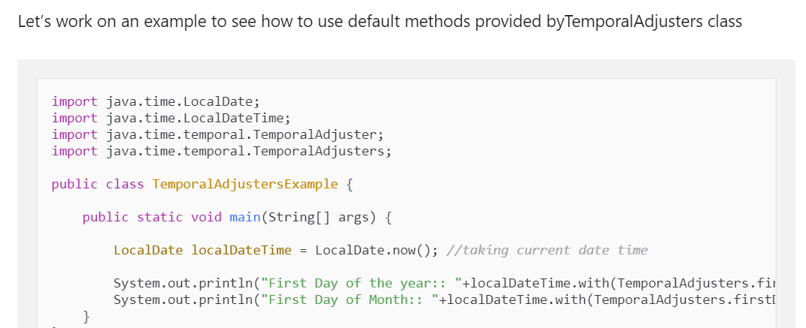

Slide 27
Custom TemporalAdjuster
This class provides a number of adjusters, however, we may come into the situation, where these adjusters will not fulfill our requirements. To handle such situations, we should create custom adjuster by implementing TemporalAdjuster interface or using Java 8 Lambda expressions.Let’s create a custom adjuster for our warehouse functionality. We will adjust shipment date by skipping the weekend.

Slide 28
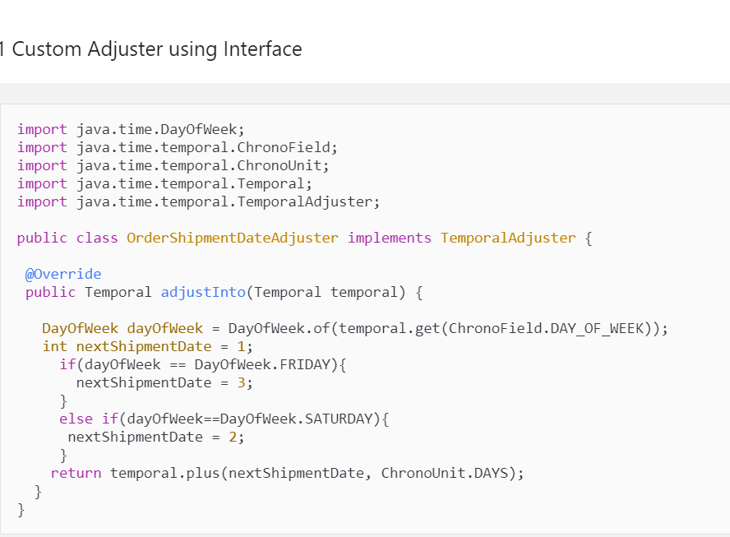

Slide 29
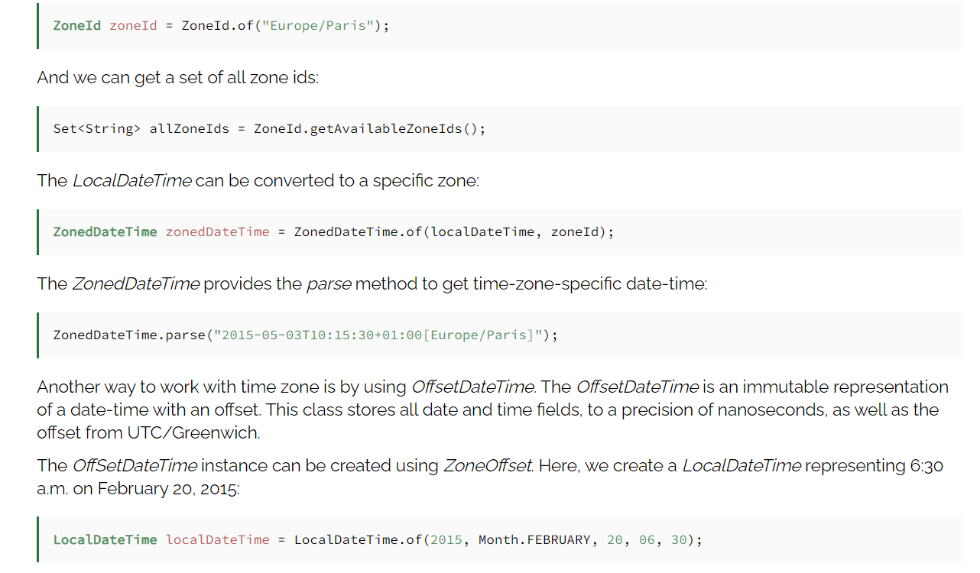

Slide 30
Using Period and Duration
The Period class represents a quantity of time in terms of years, months and days, and the Duration class represents a quantity of time in terms of seconds and nanoseconds.

Slide 31
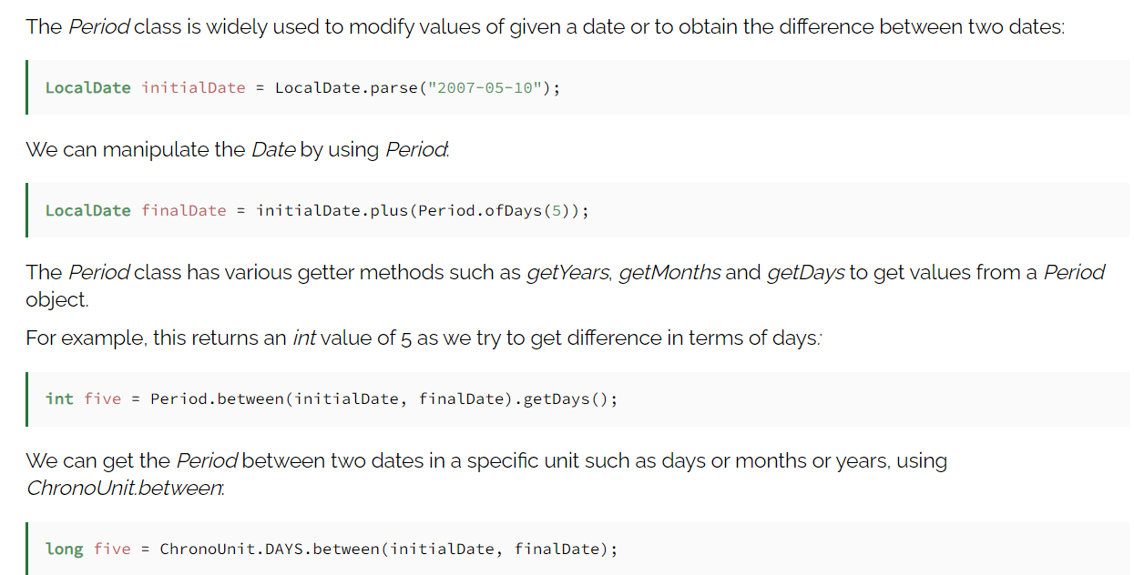
Working With Period

Slide 32
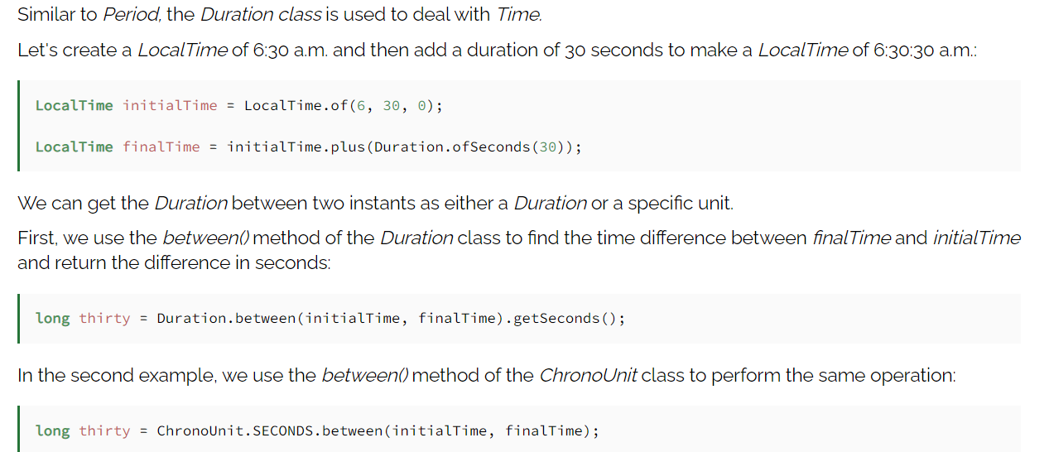
Working With Duration

Slide 33
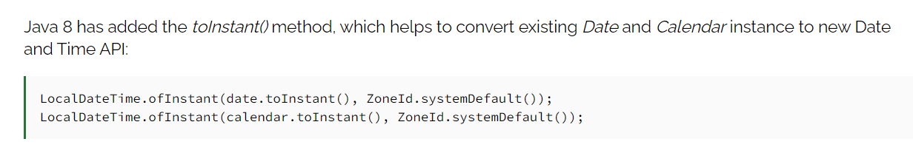
Compatibility With Date and Calendar

Slide 34
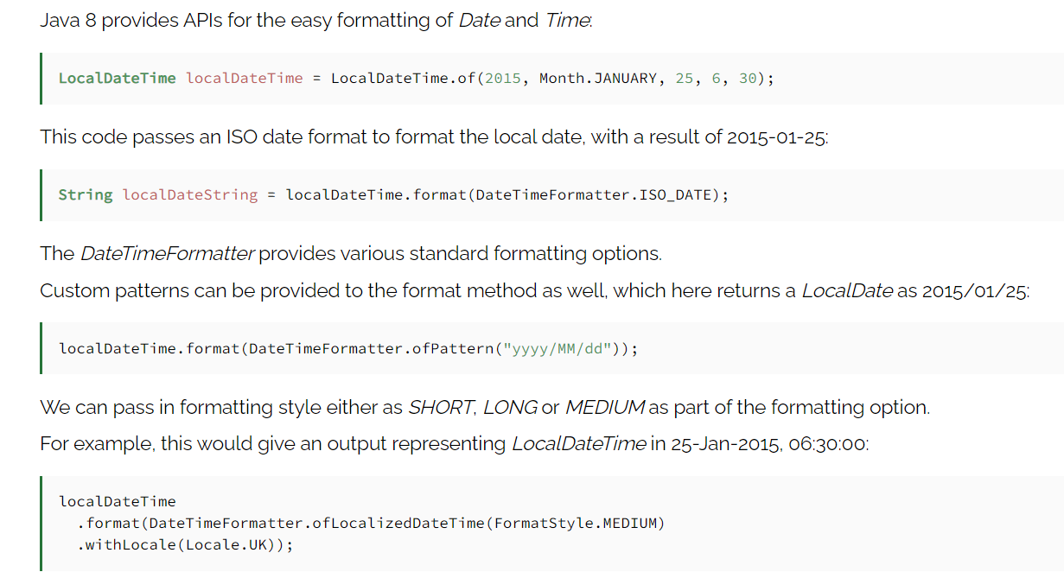
Date and Time Formatting

Slide 35
Java TimeZone Class
Java TimeZone class represents a time zone offset, and also figures out daylight savings. It inherits the Object class.

Slide 36
Java TimeZone class declaration

Slide 37
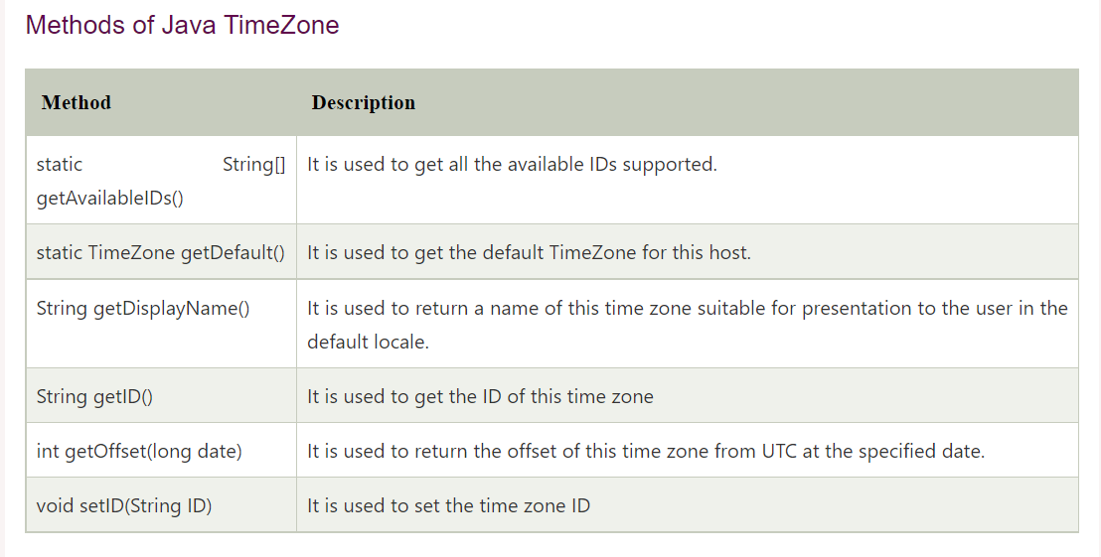

Slide 38
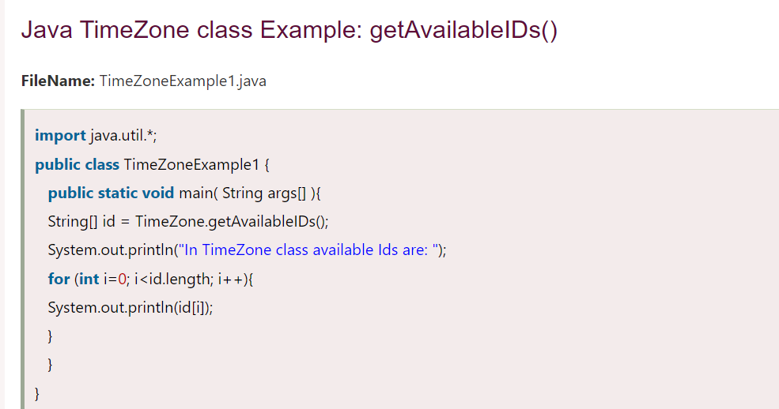

Slide 39
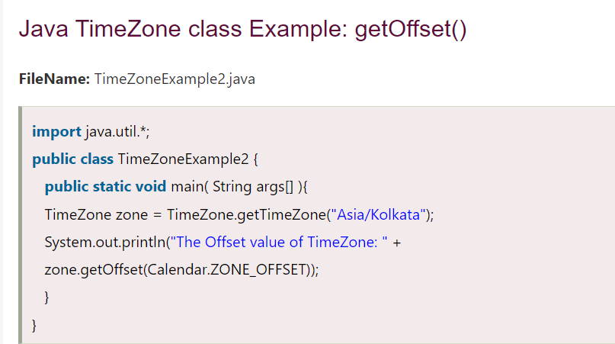

Slide 40
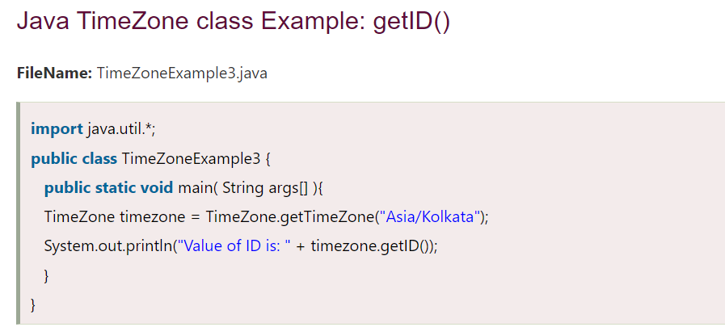

Slide 41
THANK YOU
NEEHARIKA

